Slide 1
Computer Architecture 计算机体系结构
School of Computer and Information Technology Beijing Jiaotong Univeristy
Yi Tian

Slide 2
Chapter 2. Instruction Set Architecture 指令集体系结构

Slide 3
Chapter 2 Instruction Set Architecture
2.1 Classifying Instruction Set Architecture
2.2 Interpreting Memory Address
2.3 Addressing Modes
2.4 Optimizing Instruction Formats
2.5 Operation in the Instruction Set
2.6 RISC vs. CISC
2.7 The DLX Architecture
2.8 The RISC-V Architecture

Slide 4
2. Instruction Set
指令集：计算机所有指令的集合。
一条指令由操作码与地址码构成。
指令的操作十分简单，其操作由操作码编码表示。
每个操作需要的操作数个数为0-3个不等。
操作数是一些存储单元的地址；
典型的存储单元通常有：主存、寄存器、堆栈和累加器。
操作数地址隐含表示或显式表示。
操作码
寻址方式
操作数
寻址方式
操作数

Slide 5
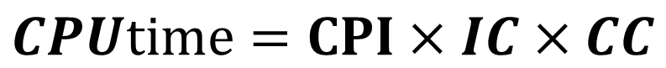
2. Instruction Set
$$CPUtime=CPI×IC×CC$$
One of the most interesting, most analyzed, aspects of computer design is instruction set design.
Defines functions of CPU, thus has significant effect on the implementation of the CPU. 定义CPU的功能，对实现有重要影响
The programmer’s means of controlling CPU. Thus, programmer requirements must be considered.程序员控制CPU的手段。要考虑程序员的需求

Slide 6
2.1 Classifying Instruction Set Architecture
♦一般来说，可以从如下五个因素考虑对计算机指令集结构进行分类，即：
在CPU中操作数的存储方法；
指令中显式表示的操作数个数；
操作数的寻址方式；
指令集所提供的操作类型；
操作数的类型和大小。

Slide 7
2.1 Classifying Instruction Set Architecture
♦ The type of internal storage in the CPU is the most basic differentiation. CPU内部存储单元的类型是最基本的区别
Major choices：
a stack, 堆栈
an accumulator, 累加器 (AC)
a set of registers. 寄存器组
♦ Operands may be named explicitly or implicitly: 指令中的操作数可以被明确地显式给出，也可以按照某种约定隐式地给出。

Slide 8
2.1 Classifying Instruction Set Architecture
指令集结构根据CPU内部存储单元类型来进行分类，一般可以分为：
Stack architecture (堆栈型指令集结构):
The operands are implicitly on the top of the stack. 操作数隐式放在堆栈结构的栈顶。
Accumulator architecture (累加器型指令集结构):
One operand is implicitly the accumulator.操作数中至少一个隐式放在累加器中。
General-purpose register architectures (GPR) (通用寄存器型指令集结构):
Have only explicit operands--either registers or memory locations. 或者是寄存器，或者是存储器位置

Slide 9
2.1 Classifying Instruction Set Architecture
♦ There are really two classes of register machines.
Register-memory architecture: access memory as part of any instruction. 寄存器-存储器体系结构
操作数可以来自存储器
Load-store or register-register architecture: access memory only with load and store instructions. 寄存器-寄存器体系结构
所有操作数都是来自寄存器
只有load与store能够访问存储器
Memory-memory architecture: A third class, not found in machines shipping today, keeps all operands in memory. 存储器-存储器体系结构，现在没有

Slide 10
2.1 Classifying Instruction Set Architecture
Figure: shows how the code sequence C =A+B would typically appear on these three classes of instruction sets. C=A+B的语句序列
Stack 堆栈 | Accumulater 累加器 | Register (register-memory) 寄存器 (寄存器-存储器) | Register (load-store) 寄存器 (寄存器-寄存器)
PUSH A PUSH B ADD POP C | LOAD A ADD B Store C | LOAD R1, A ADD R1, B Store C, R1 | LOAD R1, A LOAD R2, B ADD R3, R1, R2 Store C, R3

Slide 11
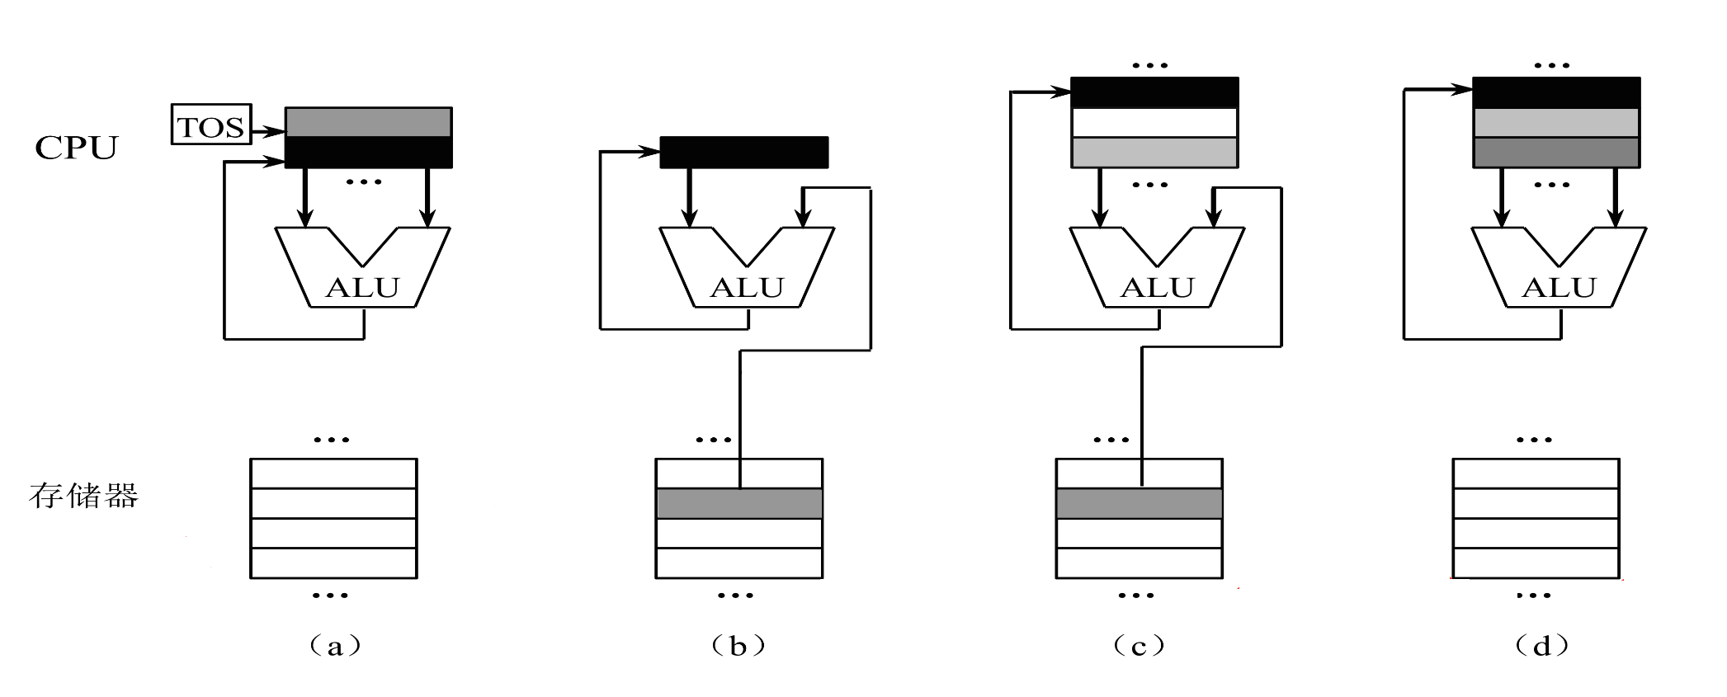
2.1 Classifying Instruction Set Architecture
Register
(register-memory)
寄存器
(寄存器-存储器)
Register
(load-store)
寄存器
(寄存器-寄存器)
Stack
堆栈
Accumulater
累加器
ADD
ADD B
ADD R1, B
ADD R3, R1, R2

Slide 12
2.1 Classifying Instruction Set Architecture
CPU提供的暂存器 | 每条ALU指令显式表示的操作数个数 | 运算结果目的地 | 访问显式操作数的过程
堆栈型 | 0 | 堆栈 | Push/Pop
累加器型 | 1 | 累加器 | Load/Store、累加器
寄存器型 | 2/3 | 寄存器或存储器 | Load/Store、寄存器/存储器

Slide 13
2.1 Classifying Instruction Set Architecture
指令集结构类型 | 优点 | 缺点
堆栈型 | 是一种表示计算的简单模型；指令短小 | 不能随机访问堆栈，从而很难生成有效代码。同时，由于堆栈是瓶颈，所以很难被高效地实现
累加器型 | 减小了机器的内部状态；指令短小 | 由于累加器是唯一的暂存器，这种机器的存储器通信开销最大
寄存器型 | 易于生成高效的目标代码 | 所有操作数均需命名，且要显式表示，因而指令比较长

Slide 14
2.1 Classifying Instruction Set Architecture
Early machines used stack or accumulator-style architectures, virtually every machine designed after 1980 uses a load-store register architecture.
The reasons for the emergence of general-purpose register (GPR) machines are as follows. 通用寄存器计算机的优势
Registers are faster than memory. 要比存储器快
Registers are easier for a compiler to use and can be used more effectively. 对编译器而言，可以更容易有效地分配和使用寄存器
More importantly, registers can hold variables. Then the memory traffic reduces, the program speeds up (faster), the code density improves (named with fewer bits). 由于寄存器能存值，使得降低了存储访问，程序加速。可用更少的地址位对寄存器进行寻址，因为寄存器数量有限，代码密度提高 。

Slide 15
2.1 Classifying Instruction Set Architecture
Two major characteristics divide GPR architectures.两种主要的指令特性能够将通用寄存器型指令集结构进一步细分
The first: whether an ALU instruction has two or three operands. ALU有两个还是三个操作数
• three-operand format: a result and two source operands. 三操作数格式：一个结果，两个源操作数 ADD R3, R1, R2
• two-operand format: one of the operands is both a source and a result for the operation. 二操作数格式：一个操作数既是源也是结果操作数 ADD R1, B
The second: how many of the operands may be memory addresses. Typically from none to three. 在ALU指令中，有多少个操作数可以用存储器来寻址，也即有多少个存储器操作数.

Slide 16
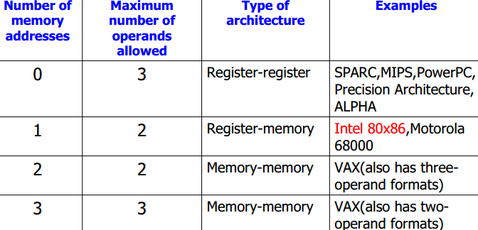
2.1 Classifying Instruction Set Architecture
Figure: Possible combinations of memory operands and total operands per typical ALU instruction with examples of machine.

Slide 17
2.1 Classifying Instruction Set Architecture
♦ FIGURE: Advantages and Disadvantages of the three most common types of general-purpose register machines.

Slide 18
2.1 Classifying Instruction Set Architecture
♦ Advantages and Disadvantages of the three most common types of general-purpose register machines.
Register-register architecture 寄存器－寄存器型（0,3）
优点：
简单，指令字长固定，是一种简单的代码生成模型，各种指令的执行时钟周期数相近。
缺点：
和指令中含有对存储器操作数访问的结构相比，指令条数多（要使用load/store），因而其目标代码较大。

Slide 19
2.1 Classifying Instruction Set Architecture
♦ Advantages and Disadvantages of the three most common types of general-purpose register machines.
Register-memory architecture 寄存器－存储器型（1,2）
优点：
可以直接对存储器操作数进行访问，容易对指令进行编码，且其目标代码较小。
缺点：
指令中的操作数类型不同。在一条指令中同时对一个寄存器操作数和存储器操作数进行编码，将限制指令所能够表示的寄存器个数。由于指令的操作数可以存储在不同类型的存储器单元，所以每条指令的执行时钟周期数也不尽相同。

Slide 20
2.1 Classifying Instruction Set Architecture
♦ Advantages and Disadvantages of the three most common types of general-purpose register machines.
Memory-memory architecture 存储器－存储器型（3,3）
优点：
是一种最紧密的编码方式，无需“浪费”寄存器保存变量。
缺点：
指令字长多种多样。每条指令的执行时钟周期数也大不一样，对存储器的频繁访问将导致存储器访问瓶颈问题。

Slide 21
2.2 Interpreting Memory Address
How memory addresses are interpreted? 存储地址是如何被解释的？
How memory addresses are specified? 存储地址如何定位？
All the instruction sets discussed in this book are byte addressed and provide access for bytes (8 bits), half words (16 bits), and words (32 bits). 字节寻址, 可访问字节、半字、字
Most of the machines also provide access for double words (64 bits). 多数计算机也可访问双字

Slide 22
2.2 Interpreting Memory Address
♦ Two different conventions for ordering the bytes within a word. 字中字节的排序：两种
Little Endian byte order puts the byte whose address is “x...x00” at the least-significant position in the word (the little end). 小端字节序：低地址装最低有效数
Big Endian byte order puts the byte whose address is “x...x00” at the most-significant position in the word (the big end). 高端字节序：低地址装最高有效数
♦ Byte order is a problem when exchanging data among machines with different orderings.
3byte | 2byte | 1byte | 0byte
x…x00
3byte | 2byte | 1byte | 0byte
x…x00

Slide 23
2.2 Interpreting Memory Address
Example: Suppose you have the 32-bit hexadecimal value 87654321 stored as a 32-bit word in byte-addressable memory at byte location 480, 481, 482, and 483.
What will be arranged in memory 480~483 according to Little Endian and Big Endian?
In which bytes order to Intel 80x86 systems store multibyte values?
Answer:
21, 43, 65, 87 will be arranged in memory 480~483 according to Little Endian.
87, 65, 43, 21 will be arranged in memory 480~483 according to Big Endian.
to Intel 80x86 systems store multibyte values in Little Endian bytes order.
87 | 65 | 43 | 21
483 482 481 480
87 | 65 | 43 | 21
480 481 482 483

Slide 24
2.2 Interpreting Memory Address
Example: 对于变量x，其地址是0x100。假设变量x的值是 0x01234567。大小端模式如何排列？
Answer:
大端
小端

Slide 25
2.2 Interpreting Memory Address
We access a word variable in the address of …xx04, what would we get in a machine of little endian ordering or big endian ordering?
 | 0x12 | 0xAD | 0x23 | 0x45 | 0x11 | 0x34 | 0xAB
…xx00 | …xx01 | …xx02 | …xx03 | …xx04 | …xx05 | …xx06 | …xx07 | …xx08
A: 0x12AD2345
B: 0x4523AD12
C: 0x451134AB
D: 0xAB341145

Slide 26
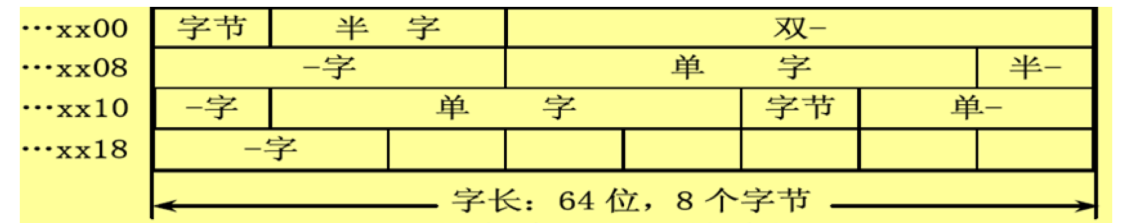
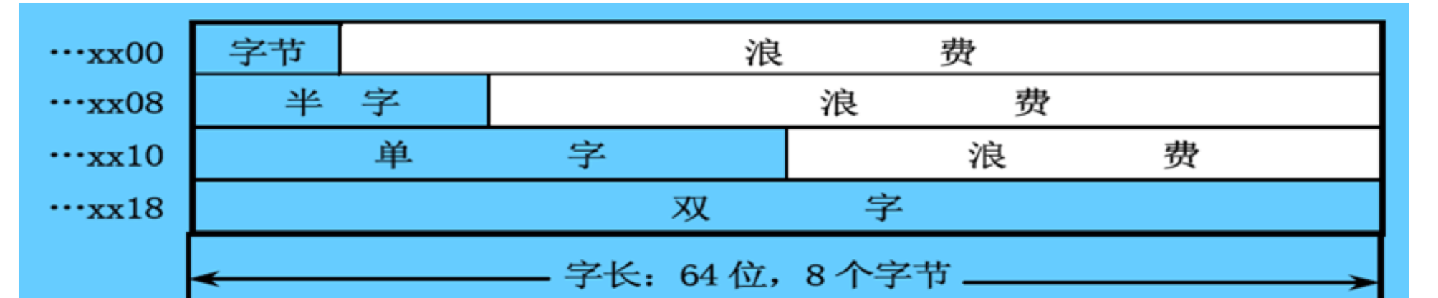
2.2 Interpreting Memory Address
Some problem.
（a） 任意位置
（b） 存储字的起始位置

Slide 27
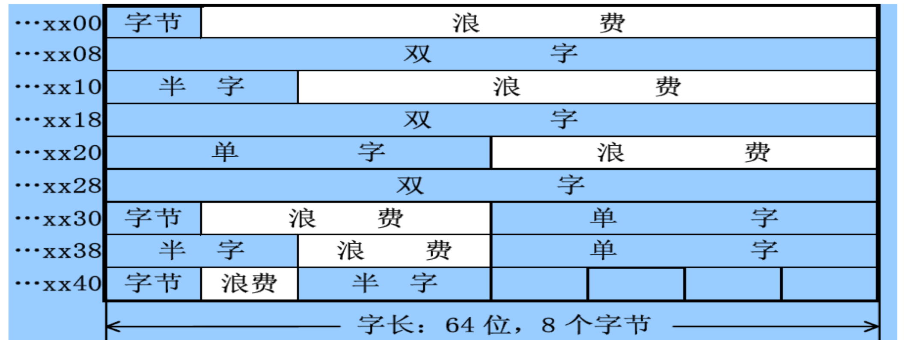
2.2 Interpreting Memory Address
Some problem.
（c） 地址的整数倍位置

Slide 28
2.2 Interpreting Memory Address
In many machines, accesses to objects larger than a byte must be aligned (对齐). An access to an object of size s bytes at byte address A is aligned if A mod s = 0.
Figure: Addresses an access is aligned or misaligned.
Object addressed | Aligned at byte offsets (Binary) | Aligned at byte offsets | Misaligned at byte offsets
Byte | x…xxxx | 0, 1, 2, 3, 4, 5, 6, 7 | Never
Half word | x…xxx0 | 0, 2, 4, 6 | 1, 3, 5, 7
Word | x…xx00 | 0, 4 | 1, 2, 3, 5, 6, 7
Double Word | x…x000 | 0 | 1, 2, 3, 4, 5, 6, 7
♦ A misaligned memory access will take multiple aligned memory references.

Slide 29
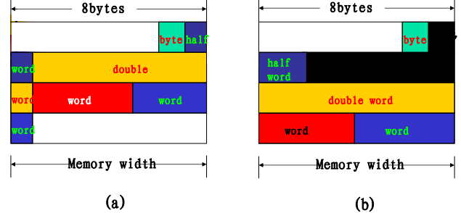
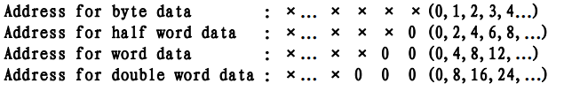
2.2 Interpreting Memory Address
In many machines, accesses to objects larger than a byte must be aligned (对齐). An access to an object of size s bytes at byte address A is aligned if A mod s = 0.
If the processor stores a variable declared as double in a C program, what is a possible memory location?

Slide 30
2.3 Addressing Modes
♦ Addressing modes --- how architectures specify the address of an object they will access. 寻址模式：指令按照什么方式寻找（访问）到所需要的操作数或信息。
In GPR machines, an addressing mode can specify an constant, a register, or a location in memory. 在通用寄存器型指令集中，一般是利用寻址方式指明指令中的操作数是一个常数、一个寄存器操作数，拟或是一个存储器操作数。
The actual memory address specified by the addressing mode is called the effective address. 寻址实际上是从形式地址到实际地址的转换。形式地址由指令描述，实际地址也称为有效地址。
有效地址指明的是存储器单元的地址或寄存器地址。

Slide 31
2.3 Addressing Modes

Slide 32
2.3 Addressing Modes

Slide 33
2.3 Addressing Modes
Register 寄存器寻址
Example instruction: Add R4 , R3
Meaning: Regs[R4]←Regs[R4]＋Regs[R3]
When used: when a value is in a register.
Immediate or literals 立即值寻址
Example instruction: Add R4 , #3
Meaning: Regs[R4]←Regs[R4]＋3
When used: for constants.

Slide 34
2.3 Addressing Modes
Register deferred or indirect 寄存器间接寻址
Example instruction: Add R4 , (R1)
Meaning: Regs[R4]←Regs[R4]＋
Mem[Regs[R1]]
When used: accessing using a pointer or a computed address.
Displacement 偏移寻址
Example instruction: Add R4 , 100(R1)
Meaning: Regs[R4]←Regs[R4]＋
Mem[100+Regs[R1]]

Slide 35
2.3 Addressing Modes
Indexed 索引寻址
Example instruction: Add R3 , (R1 + R2)
Meaning: Regs[R3]←Regs[R3]＋
Mem[Regs[R1]+Regs[R2]]
When used: sometimes useful in array addressing.
Direct or absolute 直接寻址或绝对寻址
Example instruction: Add R1 , (1001)
Meaning: Regs[R1]←Regs[R1]＋Mem[1001]
When used: sometimes useful for accessing static data; address constant may need to be large.

Slide 36
2.3 Addressing Modes
Memory indirect or memory deferred存储器间接寻址
Example instruction: Add R1 , @(R3)
Meaning: Regs[R1]←Regs[R1]＋
Mem[Mem[Regs[R3]]]
Auto increment自增寻址
Example instruction: Add R1 , (R2)+
Meaning: Regs[R1]←Regs[R1]＋Mem[Regs[R2]]
Regs[R2]←Regs[R2]＋d

Slide 37
2.3 Addressing Modes
Auto decrement 自减寻址
Example instruction: Add R1, -(R2)
Meaning: Regs[R2]←Regs[R2]－d
Regs[R1]←Regs[R1]+Mem[Regs[R2]]
Scaled 缩放寻址
Example instruction: Add R1 , 100(R2)[R3]
Meaning: Regs[R1]←Regs[R1]＋
Mem[100＋Regs[R2]＋Regs[R3]*d]

Slide 38
2.3 Addressing Modes
Affected factors of addressing modes:
Reduce instruction counts;
Add the complexity of building a machine;
Increase the average CPI of machines that implement those modes.

Slide 39
2.3 Addressing Modes
♦ Figure: the results of measuring addressing mode usage patterns in three programs on VAX architecture.
♦ As Figure shows, immediate and displacement addressing dominate addressing mode usage.

Slide 40
2.3 Addressing Modes
Displacement Addressing Mode 偏移寻址
Example instruction: Add R4 , 100(R1)
Meaning: Regs[R4]←Regs[R4]＋Mem[100+Regs[R1]]
♦ The major question: the range of displacements used. 位移范围多大
♦ Choosing the displacement field sizes is important because they directly affect the instruction length. 重要：直接影响指令大小

Slide 41
2.3 Addressing Modes
Displacement Addressing Mode 偏移寻址
♦ Figure: Displacement values are widely distributed
♦ Summary: 12bits of displacement would capture about 75% of the full 32bit displacement and 16bits would capture about 99%.

Slide 42
Computer Architecture 计算机体系结构
School of Computer and Information Technology Beijing Jiaotong Univeristy
Yi Tian

Slide 43
2.1 Classifying Instruction Set Architecture
指令集结构根据CPU内部存储单元类型来进行分类，一般可以分为：
Stack architecture (堆栈型指令集结构):
The operands are implicitly on the top of the stack. 操作数隐式放在堆栈结构的栈顶。
Accumulator architecture (累加器型指令集结构):
One operand is implicitly the accumulator.操作数中至少一个隐式放在累加器中。
General-purpose register architectures (GPR) (通用寄存器型指令集结构):
Have only explicit operands--either registers or memory locations. 或者是寄存器，或者是存储器位置

Slide 44
2.1 Classifying Instruction Set Architecture
♦ There are really two classes of register machines.
Register-memory architecture: access memory as part of any instruction. 寄存器-存储器体系结构
操作数可以来自存储器
Load-store or register-register architecture: access memory only with load and store instructions. 寄存器-寄存器体系结构
所有操作数都是来自寄存器
只有load与store能够访问存储器
Memory-memory architecture: A third class, not found in machines shipping today, keeps all operands in memory. 存储器-存储器体系结构，现在没有

Slide 45
2.2 Interpreting Memory Address
♦ Two different conventions for ordering the bytes within a word. 字中字节的排序：两种
Little Endian byte order puts the byte whose address is “x...x00” at the least-significant position in the word (the little end). 小端字节序：低地址装最低有效数
Big Endian byte order puts the byte whose address is “x...x00” at the most-significant position in the word (the big end). 高端字节序：低地址装最高有效数
♦ Byte order is a problem when exchanging data among machines with different orderings.
3byte | 2byte | 1byte | 0byte
x…x00
3byte | 2byte | 1byte | 0byte
x…x00

Slide 46
2.2 Interpreting Memory Address
In many machines, accesses to objects larger than a byte must be aligned (对齐). An access to an object of size s bytes at byte address A is aligned if A mod s = 0.
Figure: Addresses an access is aligned or misaligned.
Object addressed | Aligned at byte offsets (Binary) | Aligned at byte offsets | Misaligned at byte offsets
Byte | x…xxxx | 0, 1, 2, 3, 4, 5, 6, 7 | Never
Half word | x…xxx0 | 0, 2, 4, 6 | 1, 3, 5, 7
Word | x…xx00 | 0, 4 | 1, 2, 3, 5, 6, 7
Double Word | x…x000 | 0 | 1, 2, 3, 4, 5, 6, 7
♦ A misaligned memory access will take multiple aligned memory references.

Slide 47
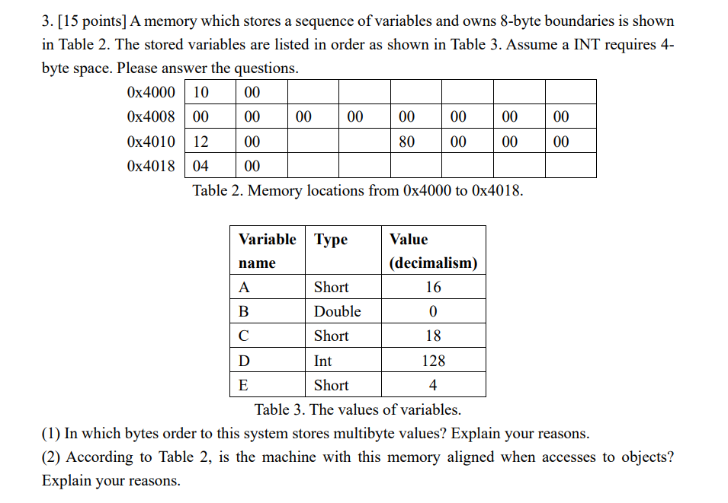

Slide 48
2.3 Addressing Modes

Slide 49
2.3 Addressing Modes

Slide 50
2.3 Addressing Modes
♦ Figure: the results of measuring addressing mode usage patterns in three programs on VAX architecture.
♦ As Figure shows, immediate and displacement addressing dominate addressing mode usage.

Slide 51
2.3 Addressing Modes
Immediate or Literal Addressing Mode立即值寻址
Example instruction: Add R4 , #3
Meaning: Regs[R4]←Regs[R4]＋3
♦ Immediates can be used in arithmetic operations, in comparisons (primarily for branches), and in moves where a constant is wanted in a register. 可用于算数、比较、移动
♦ It is important to know whether Immediates need to be supported for all operations or for only a subset. 是否所有操作都支持？

Slide 52
2.3 Addressing Modes
Immediate or Literal Addressing Mode立即值寻址
♦ Figure: frequency of immediates for the general classes of integer operations
♦ For integer ALU operations about 1/2 to 3/4 have an immediate operand, while for integer compares 75% to 85% use an immediate operand.

Slide 53
2.3 Addressing Modes
Immediate or Literal Addressing Mode立即值寻址
Example instruction: Add R4 , #3
Meaning: Regs[R4]←Regs[R4]＋3
♦ Another important measurement is the range of values for immediates. 立即数的范围
♦ Like displacement values, the sizes of immediate values affect instruction lengths. 像偏移值一样，立即数大小也影响指令大小

Slide 54
2.3 Addressing Modes
Immediate or Literal Addressing Mode立即值寻址
♦ Figure: Distribution of immediate values.
♦ Note: 50% to 70% of the immediates fit within 8 bits and 75% to 80% fit within 16 bits.
♦ As the following Figure shows, immediate values that are small are most heavily used. Large immediates are sometimes used, most likely in addressing calculations.小立即数最常使用，大立即数有时用，多用于地址计算

Slide 55
2.3 Addressing Modes
Summary: Memory Addressing 总结: 存储器寻址
♦ First, a new architecture should support at least: displacement, immediate, and register deferred. They represent 75% to 99% of the addressing modes. 至少应支持这三种寻址模式。
♦ Second, the size of the address for displacement mode should be at least 12 to 16 bits, these sizes would capture 75% to 99% of the displacements. 位移至少12到16位
♦ Third, the size of the immediate field should be at least 8 to 16 bits. these sizes would capture 50% to 80% of the immediates. 立即数至少8到16位

Slide 56
2.4 Optimizing Instruction Formats
The most basic design issue of an instruction format is the instruction format length. 指令格式设计的基本问题: 指令格式长度
A trade-off between the desire for the powerful instruction repertoire and a need to save space.
Beyond the basic trade-off, either the instruction length should be equal to the memory-transfer length or one should be a multiple of the other.
For a given instruction length, there is clearly a trade-off between the number of opcodes and the power of the addressing capability. 操作码数和寻址能力的折中取舍

Slide 57
2.4 Optimizing Instruction Formats
Opcodes Representation 操作码表示
♦ There are three types of representations for opcodes, which are fixed length, Huffman-coding, and extended opcodes.
Fixed-length Opcodes 固定长度的操作码
The n is number of opcodes in the machine.
Binary bits of opcodes = ⎡log₂n⎤
Advantages: simple hardware decoding and regularity. 简化硬件设计和减少指令译码时间
Disadvantages: Wastes memory space. 浪费空间
Example: 指令集中共有5种操作指令，则n=?
在指令字第一字节表示操作码，那么有多少种操作？

Slide 58
2.4 Optimizing Instruction Formats
Opcodes Representation 操作码表示
Huffman coding 哈夫曼编码
The idea behind Huffman coding is simply to use shorter bit patterns for more common characters. 用更少的位表示更常出现的字符
Suppose N characters, with probabilities P_{i}, i=1,…, N, so that ∑P_{i}=1. The information theory says that strings consisting of these characters require, on the average, at least H bits per character.

Slide 59
2.4 Optimizing Instruction Formats
Opcodes Representation 操作码表示
Huffman coding 哈夫曼编码
Huffman coding: variable code word length, helps to decrease the amount of redundancy. It makes data compression possible. 变长编码, 降低冗余, 实现数据压缩
Comparing with Huffman coding, fixed-length coding information redundancy is: 固定长度编码的冗余度：

Slide 60
2.4 Optimizing Instruction Formats
Opcodes Representation 操作码表示
Huffman coding 哈夫曼编码
The algorithm for building Huffman code is based on the so-called “coding tree”. The algorithm steps are:
Step 1. Line the symbols in increasing probabilities. 从小到大排序
Step 2. Merge two symbols with least probabilities into one new symbol with probability as the sum of the probabilities of the two symbols. 将最小的两个合并
Step 3. Repeat above steps until only one symbol is left probability 1. 重复上述过程直至最后概率为1
Step 4. Trace the tree from the root to the original symbols, and assign to left branch 1, and to right branch 0. 编码

Slide 61
2.4 Optimizing Instruction Formats
Opcodes Representation 操作码表示
Huffman coding 哈夫曼编码
Example: Huffman encoding for seven instructions model machine
Instruction Sequence | Probability
I1 | 0.45
I2 | 0.30
I3 | 0.15
I4 | 0.05
I5 | 0.03
I6 | 0.01
I7 | 0.01

Slide 62
2.4 Optimizing Instruction Formats
Opcodes Representation 操作码表示
Huffman coding 哈夫曼编码
Example:
Instruction Sequence | Probability
I1 | 0.45
I2 | 0.30
I3 | 0.15
I4 | 0.05
I5 | 0.03
I6 | 0.01
I7 | 0.01
1.00
1
1
0.55
0.25
0
1
0.10
0
1
0
0.05
1
0
0.02
0
1
0
0.01
0.01
0.03
0.05
0.15
0.30
0.45

Slide 63
2.4 Optimizing Instruction Formats
Opcodes Representation 操作码表示
Huffman coding 哈夫曼编码
Example:
Instruction Sequence | Probability | Huffman Coding | Opcode Length
11 | 0.45 | 0 | 1 bit
12 | 0.30 | 10 | 2 bits
13 | 0.15 | 110 | 3 bits
14 | 0.05 | 1110 | 4 bits
15 | 0.03 | 11110 | 5 bits
16 | 0.01 | 111110 | 6 bits
17 | 0.01 | 111111 | 6 bits
♦ The average minimize bits pattern:
H = 0.45×1 + 0.30×2 + 0.15×3 + 0.05×4
+ 0.03×5 + 0.01×6 + 0.01×6 = 1.97 (bits)

Slide 64
2.4 Optimizing Instruction Formats
Opcodes Representation 操作码表示
Huffman coding 哈夫曼编码
Notice:
No codeword is a prefix of any other codeword. For example, we have a codeword 0, so no other codeword starts with 0. Such code are called prefix codes. 前缀码: 任何码字都不是其他码字的前缀
Prefix codes are useful because they make a stream of bits unambiguous. 无二义性
Prefix codes always can be used to achieve the optimal compression for a character code. 用来达到最佳压缩

Slide 65
2.4 Optimizing Instruction Formats
Opcodes Representation 操作码表示
Extended Opcodes 扩展码
Huffman coding has the least average bits pattern and redundancy, but with irregular coding structure. 哈夫曼码的位数最少, 冗余最小, 但结构不整齐
Extended opcodes are supposed as the trade-off. 扩展码是一个折中

Slide 66
2.4 Optimizing Instruction Formats
Opcodes Representation 操作码表示
Extended Opcodes 扩展码
Instruction Sequence | Probability | Huffman Coding | 1-2-3-5 extended coding | 2-4 extended coding
11 | 0.45 | 0 | 0 | 00
12 | 0.30 | 10 | 10 | 01
13 | 0.15 | 110 | 110 | 10
14 | 0.05 | 1110 | 11100 | 1100
15 | 0.03 | 11110 | 11101 | 1101
16 | 0.01 | 111110 | 11110 | 1110
17 | 0.01 | 111111 | 11111 | 1111

Slide 67
2.4 Optimizing Instruction Formats
Opcodes Representation 操作码表示
Extended Opcodes 扩展码
We could have several extended method according to instruction distribution probabilities such as 15/15/15, 8/64/512, extend coding etc.
0000
0001
…
1110
0000
0001
…
0111
15
8
1111 0000
1111 0001
…
1111 1110
1000 0000
1000 0001
…
1111 0111
15
64
1111 1111 0000
1111 1111 0001
…
1111 1111 1110
1000 1000 0000
1000 1001 0001
…
1111 1111 0111
15
512
15/15/15 8/64/512

Slide 68
2.4 Optimizing Instruction Formats
Opcodes Representation 操作码表示
Example: There is a model machine with 14 instructions, which frequencies are 0.01, 0.15, 0.12, 0.03, 0.02, 0.04, 0.02, 0.04, 0.01, 0.13, 0.15, 0.14, 0.11, 0.03. Encode the 14 instructions with fixed-length coding, Huffman coding, only two kinds of length extended coding respectively. Give the average code length.
Answer:
1) Fixed-length coding:
The average code length for fixed-length coding:
⎡log₂14⎤ = 4 bits

Slide 69
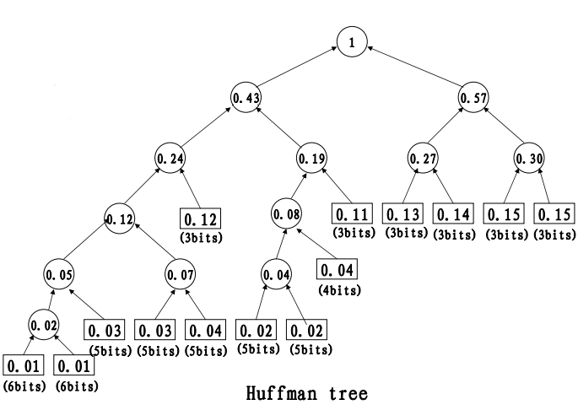
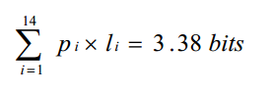
2.4 Optimizing Instruction Formats
Opcodes Representation 操作码表示
Answer:2) Huffman coding:
The average code length for Huffman coding:

Slide 70
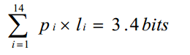
2.4 Optimizing Instruction Formats
Opcodes Representation 操作码表示
Answer:
3) extended coding: two kinds of length extended
0.01 0.01 0.02 0.02 0.03 0.03 0.04 0.04 0.11 0.12 0.13 0.14 0.15 0.15
The 14 instructions can be combined by two groups: the bigger frequencies instructions and the smaller ones. The bigger ones include 6 instrcutions:0.15, 0.15, 0.14, 0.13, 0.12, 0.11 and they are encoded into 000-101. The rest code: 110 and 111 are extended 2 bits each to form 8codes. This 8 codes are needed by the rest smaller frequencies 8 instructions.
The average code length for extended coding:

Slide 71
2.4 Optimizing Instruction Formats
Number of Operands 操作数
We could have either three operands, two operands, one operand explicit instruction format or zero operant implicit instruction format. 可有(明确给出)3个、2个、1个操作数的指令格式，或者有0个操作数的(隐含操作数)指令格式
OP | A₁ | A₂ | A₃
三操作数
OP | A₁ | A₂
二操作数
OP | A₁
一操作数
OP
0操作数
♦ We could use indirect addressing, register indirect addressing and displacement addressing mode to shorten operand length.可用间接寻址、寄存器间接寻址、偏移寻址来缩短操作数长度

Slide 72
2.4 Optimizing Instruction Formats
Encoding An Instruction Set 指令集编码
♦ The operation is typically specified in one field, called the opcode. The important decision is how to encode the addressing modes with the operations.
1) Addressing mode can be encoded as part of opcode. Load-store machine with only one memory operand and only one or two addressing modes. 将寻址方式编码于操作码中，由操作码在描述指令操作的同时，也描述了相应操作的寻址方式
2) For machines with a large combinations of operands × addressing modes , typically an address specifier is needed for each operand. Address specifier tells what addressing mode is used to access the operand. 为每个操作数设置一个地址描述符，由该地址描述符表示相应操作数的寻址方式
操作码
AD1
AF1
AD2
AF2
AD3
AF3

Slide 73
2.4 Optimizing Instruction Formats
Encoding An Instruction Set 指令集编码
We must balance several competing forces when encoding instruction set.
Principles:
1. The desire to have as many registers and addressing modes as possible. 寄存器和寻址模式越多越好
2. The impact of the size of the register and addressing mode fields on average instruction size and hence on average program size. 充分考虑寄存器字段和寻址模式字段的大小对平均指令大小的影响，以及对程序大小的影响
3. A desire to encode instructions into lengths that are easy to handle. Architect wants instructions to be in multiples of bytes, rather than arbitrary length.设计出的指令集格式能够在具体实现中容易处理.指令字长应该是字节的整数倍，而不是任意的位数

Slide 74
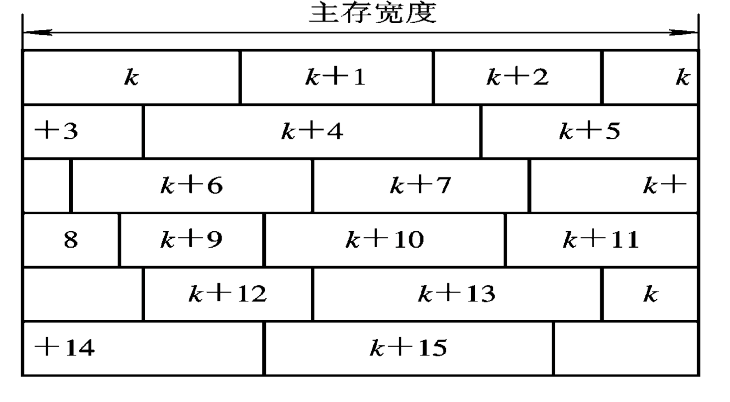
2.4 Optimizing Instruction Formats
Encoding An Instruction Set 指令集编码
任意字长指令在按位编址主存中存贮：

Slide 75
2.4 Optimizing Instruction Formats
Encoding An Instruction Set 指令集编码
Three popular choices for encoding the instruction set:
The first we call variable(变长), since it allows virtually all addressing modes to be with all operations, is best when there are many addressing modes and operations. 允许所有操作有任何寻址模式，当有很多寻址模式和操作时最佳
The second we call fixed(定长), combines the operation and the addressing mode into the opcode. It works best when there are few addressing modes and operations. 将操作和寻址模式结合到操作码域，当有很少寻址模式和操作时最佳
The third called hybrid (混合), is a trade-off between the size of programs versus ease of decoding. 程序大小与易于解码之间的折中

Slide 76
2.4 Optimizing Instruction Formats
Encoding An Instruction Set 指令集编码
Three popular choices for encoding the instruction set:
Variable
操作码
AD1
AF1
AD2
AF2
AD3
AF3
Fixed
操作码
地址1
地址2
地址3
Hybrid
操作码
AD
AF
操作码
AD
AF1
AF2
操作码
AD
AF1
AD2
AF2

Slide 77
2.5 Operation in the Instruction Set
♦ The operators supported by most instruction set architectures can be categorized in the following Figure.
Arithmetic and logical 算术和逻辑运算 | Integer arithmetic and logical: add, and, subtract, multiple, divide 整数的算术和逻辑操作：加、减、与、或等
Data transfer 数据传输 | Load/Store (move instructions on machines with memory addressing)
Control 控制 | Branch, jump, procedure call and return, traps 分支、跳转、过程调用和返回、自陷等
System 系统 | Operating system call, virtual memory management instructions 操作系统调用、虚拟存储器管理等
Floating point 浮点 | Floating-point operations: add, multiply 浮点操作：加、乘等
Decimal 十进制 | Decimal add, decimal multiply, decimal-to-character conversions 十进制加、十进制乘、十进制到字符的转换
String 字符串 | String move, string compare, string search 字符串移动、字符串比较、字符串搜索等
Graphics 图形 | Pixel operations, compression/decompression operations 像素操作、压缩/解压操作等

Slide 78
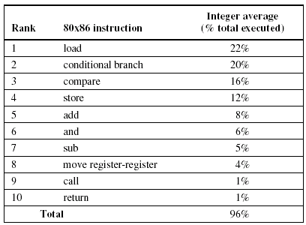
2.5 Operation in the Instruction Set
One rule of thumb across is that the most widely executed instructions are the simple operations of an instruction set. 多数广泛执行的指令是简单操作
The following figure shows 10 simple instructions that account for 96% of instructions executed for a collection of integer programs running on the popular Intel 80x86.
The implementor of these instructions should be sure to make these instructions fast, as they are the common case. 应快速实现这些指令

Slide 79
2.5 Operation in the Instruction Set
Instructions for Control Flow 控制流指令
Jump (跳转): when the change in control is unconditional. 控制指令为无条件改变控制流时，我们称之为“跳转”
Branch (转移): when the change is conditional. 控制指令是有条件改变控制流时，我们称之为“分支”
♦ We can distinguish four different types of control-flow change: 四种控制流改变
1) Conditional branches 条件转移
2) Jumps 跳转
3) Procedure calls 过程调用
4) Procedure returns 过程返回

Slide 80
2.5 Operation in the Instruction Set
Instructions for Control Flow 控制流指令
The frequencies of these instructions for a load-store machine are shown in the following figure. Conditional branches clearly dominate.

Slide 81
2.5 Operation in the Instruction Set
Instructions for Control Flow 控制流指令
Addressing Modes for Control Flow Instructions 控制流指令的寻址模式
The destination address of a control flow instruction must always be specified, and is specified explicitly in the instruction in the majority of cases. 大多情况,明确规定目标地址
The most common way: specify the destination is to supply a displacement that is added to the program counter (PC), called PC-relative (PC相对). 最常用方法：一旦转移成功，在当前PC counter上加上一个偏移量，作为目标地址
Advantages: PC-relative branches or jumps are advantageous because the target is often near the current instruction, and specifying the position relative to current PC requires fewer bits. 一般该偏移量用较少的位数表示 BEQZ R4, name

Slide 82
2.5 Operation in the Instruction Set
Instructions for Control Flow 控制流指令
Addressing Modes for Control Flow Instructions 控制流指令的寻址模式
To implement returns and indirect jumps in which the target is not known at compile time, a method other than PC-relative addressing is required. 返回或非直接跳转要采取另外的寻址方法
There must be a way to specify the target dynamically, so that it can change at runtime. 必须动态确定目标地址
This dynamic address may be as simple as naming a register that contains the target address. 可命名一个寄存器,它包含目标地址

Slide 83
2.5 Operation in the Instruction Set
Instructions for Control Flow 控制流指令
Addressing Modes for Control Flow Instructions 控制流指令的寻址模式
As branches generally use PC-relative addressing to specify their targets, a key question concerns how far branch targets are from branches. 关键问题：转移到多远？
Knowing the distribution of these displacements will help in choosing what branch offsets to support and thus will affect the instruction length and encoding. 知道位移大小的分布情况有助于确定对转移偏移量的选择, 并影响指令长度和编码。

Slide 84
2.5 Operation in the Instruction Set
Instructions for Control Flow 控制流指令
Addressing Modes for Control Flow Instructions 控制流指令的寻址模式
PC-relative:
Short displacement fields often suffice for branches. 小的位移域足够用于转移

Slide 85
2.5 Operation in the Instruction Set
Conditional Branch Options 条件转移的选项
Since most changes in control flow are branches, deciding how to specify the branch condition is important. 如何规定转移条件很重要
Three primary techniques and their advantages and disadvantages are shown in following Figure.
分支条件表示 | 优 点 | 缺 点
Condition code 条件码（CC）：在程序的控制下，由ALU操作设置特殊的位 | 可以自由设置分支条件 | 必须从一条指令将分支条件信息传送到分支指令，所以CC是额外状态，条件码限制了指令执行顺序
Condition register 条件寄存器：根据比较结果测试条件寄存器 | 简单 | 占用了一个寄存器
Compare and branch 比较分支：比较操作是分支指令的一部分，比较受限制 | 一条指令完成了两条指令的功能 | 分支指令的操作增多。当采用流水线时，该指令的操作可能太多，在一拍内做不完。

Slide 86
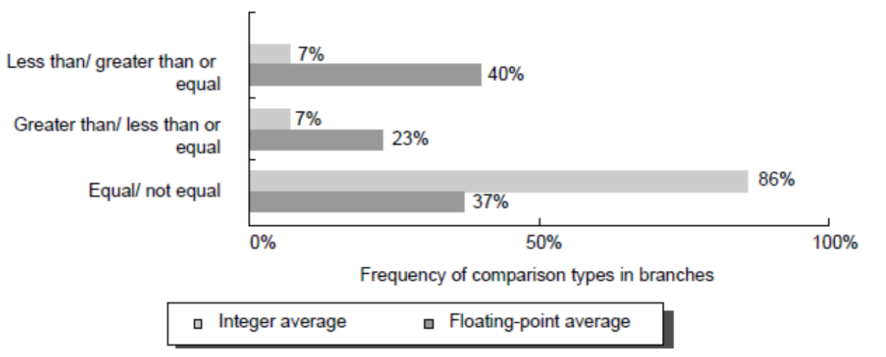
2.5 Operation in the Instruction Set
Conditional Branch Options 条件转移的选项
One of the most noticeable properties of branches is that a large number of the comparisons are simple equality or inequality tests, and are comparisons with zero. 多数的比较是简单的等式和不等式检测, 以及与零比较
Thus, some architectures choose to treat these comparisons as special cases, especially if a compare and branch instruction is used. 一些体系结构将这些比较看作特殊情况。尤其是采用比较和转移分支指令时。

Slide 87
2.5 Operation in the Instruction Set
Procedure Invocation Options 过程调用选项
Procedure calls and returns include control transfer and possibly some state saving. 过程调用和返回包括控制转移和可能的一些状态保存。
Two basic conventions to save registers:
Caller saving (调用者保存): the calling procedure must save the registers that it wants preserved for access after the call. 在一个调用者调用别的过程时，必须保存调用者所要保存的寄存器，以备调用结束返回后，能够再次访问调用者。
Callee saving (被调用者保存): the called procedure must save the registers it wants to use. 被调用的过程必须保存它要用的寄存器，保证不会破坏过程调用者的程序执行环境，并在过程调用结束返回时，恢复这些寄存器的内容。

Slide 88
2.5 Operation in the Instruction Set
Procedure Invocation Options 过程调用选项
Example:

Slide 89
2.6 RISC vs. CISC
RISC vs. CISC Technology RISC与CISC技术
CISC (Complex Instruction Set Computers)—复杂指令集计算机-- is to complete a task in as few lines of assembly as possible. This is achieve by building processor hardware that is capable of understanding and executing a series of operations. CISC的目标：汇编语言程序量小, 这通过硬件来实现。强化指令功能，实现软件功能向硬件功能转移
CISC结构指令系统的复杂性给VLSI设计增加了很大负担，不利于单片集成。
CISC结构的指令系统中，许多复杂指令需要很复杂的操作，因而运行速度慢。
在CISC结构的指令系统中，由于各条指令的功能不均衡性，不利于采用先进的计算机体系结构技术（如流水技术）来提高系统的性能。

Slide 90
2.6 RISC vs. CISC
The following figure shows 10 simple instructions that account for 96% of instructions executed for a collection of integer programs running on the popular Intel 80x86.

Slide 91
2.6 RISC vs. CISC
RISC vs. CISC Technology RISC与CISC技术
♦ RISC (Reduced Instruction Set Computer) --精简指令集计算机-- is a microprocessor that is designed to perform a smaller number of types of computer instruction so that is can operate at a higher speed. 指令类型少，运行快
One advantage of RISC is that they can execute instructions very fast because the instructions are so simple. 指令简单, 因此运行非常快
Another, perhaps more important advantage, is that RISC chips require fewer transistors, which makes them cheaper to design and produce. 需要更少的晶体管, 设计和制造更便宜

Slide 92
2.6 RISC vs. CISC
Characteristic of CISC and RISC CISC和RISC的特点
♦ The main characteristics of CISC:
Extensive instructions.
Complex and efficient machine instructions.
Microencoding of the machine instructions.
Extensive addressing capabilities for memory operations.
Relatively few registers.
♦ RISC processors are more or less the opposite:
Reduced instruction set.
Less complex, simple instructions.
Hardwired control unit and machine instructions.
Few addressing schemes for memory operands with only two basic instructions: LOAD and STORE.
Many symmetric registers which are organized into a register file.

Slide 93
2.6 RISC vs. CISC
Debating on RISC and CISC RISC与CISC的争论
♦ The controversy about RISC: 争论
Proponents: RISC are both cheaper and faster, and are therefore the machines of future.
However, RISC put a greater burden on the software. Is this worth the trouble because conventional microprocessors are becoming increasingly fast and cheap ?
The argument is becoming moot because CISC and RISC implementations are becoming more and more alike. Many of today’s RISC support as many as instructions as yesterday’s CISC. And today’s CISC chips use many techniques formerly associated with RISC chips.

Slide 94
2.6 RISC vs. CISC
RISC Design Features RISC设计特征
♦ RISC concepts of individual manufacturers are similar, such as:
Reduction of the instruction set.选取使用频率最高的指令，并补充一些最有用的指令
One cycle execution time. Simple instruction, Easy to pipelining, execution fast. CPI=1每条指令的功能应尽可能简单，并在一个机器周期内完成
Instruction pipelining. 指令流水线
Fixed length of instructions, easy to decode.
Load/store architecture. 只有load和store指令能访问存储器, 其它指令操作均在寄存器之间进行
Unity of RISC processors and compilers. 处理器与编译器联合开发
A modified register concept. 在某些RISC中, 对快速的子程序调用, 寄存器不再是以ax, bx等方式来管理, 而是以变量窗口的形式存在, 能看到某组寄存器文件.

Slide 95
2.6 RISC vs. CISC
♦ The execution structure of an instruction is the following steps:
read the instruction from memory (instruction fetching) 取指令
decode the instruction(decoding phase) 译码
where necessary, fetch operand(s) (operand fetching phase) 取操作数
execute the instruction(execution phase) 执行
write back the result(write-back phase) 写回
♦ Every instruction is broken down into partial steps for execution in the stage pipeline. The partial steps are executed within one single clock cycle.

Slide 96
2.6 RISC vs. CISC
Latest developments in RISC design
RISC设计的最新进展
♦ With some processors the phases are combined into one phase. 有些阶段可合并
♦ However, instruction phases can be sub-divided further, leading to a superpipelined architecture with many pipeline stages(ten or more). 超流水线, 但实现困难, 不太用
♦ Another possibility is the integration of many pipelines operating in parallel. The result is a superscalar. 超标量

Slide 97
Computer Architecture 计算机体系结构
School of Computer and Information Technology Beijing Jiaotong Univeristy
Yi Tian

Slide 98
2.4 Optimizing Instruction Formats
Opcodes Representation 操作码表示
♦ There are three types of representations for opcodes, which are fixed length, Huffman-coding, and extended opcodes.
Fixed-length Opcodes 固定长度的操作码
Huffman coding 哈夫曼编码
Extended Opcodes 扩展码

Slide 99
2.4 Optimizing Instruction Formats
Number of Operands 操作数
We could have either three operands, two operands, one operand explicit instruction format or zero operant implicit instruction format. 可有(明确给出)3个、2个、1个操作数的指令格式，或者有0个操作数的(隐含操作数)指令格式
OP | A₁ | A₂ | A₃
三操作数
OP | A₁ | A₂
二操作数
OP | A₁
一操作数
OP
0操作数
♦ We could use indirect addressing, register indirect addressing and displacement addressing mode to shorten operand length.可用间接寻址、寄存器间接寻址、偏移寻址来缩短操作数长度

Slide 100
2.4 Optimizing Instruction Formats
Encoding An Instruction Set 指令集编码
♦ The operation is typically specified in one field, called the opcode. The important decision is how to encode the addressing modes with the operations.
1) Addressing mode can be encoded as part of opcode. Load-store machine with only one memory operand and only one or two addressing modes. 将寻址方式编码于操作码中，由操作码在描述指令操作的同时，也描述了相应操作的寻址方式
2) For machines with a large combinations of operands × addressing modes , typically an address specifier is needed for each operand. Address specifier tells what addressing mode is used to access the operand. 为每个操作数设置一个地址描述符，由该地址描述符表示相应操作数的寻址方式
操作码
AD1
AF1
AD2
AF2
AD3
AF3

Slide 101
2.4 Optimizing Instruction Formats
Encoding An Instruction Set 指令集编码
Three popular choices for encoding the instruction set:
The first we call variable(变长), since it allows virtually all addressing modes to be with all operations, is best when there are many addressing modes and operations. 允许所有操作有任何寻址模式，当有很多寻址模式和操作时最佳
The second we call fixed(定长), combines the operation and the addressing mode into the opcode. It works best when there are few addressing modes and operations. 将操作和寻址模式结合到操作码域，当有很少寻址模式和操作时最佳
The third called hybrid (混合), is a trade-off between the size of programs versus ease of decoding. 程序大小与易于解码之间的折中

Slide 102
2.5 Operation in the Instruction Set
♦ The operators supported by most instruction set architectures can be categorized in the following Figure.
Arithmetic and logical 算术和逻辑运算 | Integer arithmetic and logical: add, and, subtract, multiple, divide 整数的算术和逻辑操作：加、减、与、或等
Data transfer 数据传输 | Load/Store (move instructions on machines with memory addressing)
Control 控制 | Branch, jump, procedure call and return, traps 分支、跳转、过程调用和返回、自陷等
System 系统 | Operating system call, virtual memory management instructions 操作系统调用、虚拟存储器管理等
Floating point 浮点 | Floating-point operations: add, multiply 浮点操作：加、乘等
Decimal 十进制 | Decimal add, decimal multiply, decimal-to-character conversions 十进制加、十进制乘、十进制到字符的转换
String 字符串 | String move, string compare, string search 字符串移动、字符串比较、字符串搜索等
Graphics 图形 | Pixel operations, compression/decompression operations 像素操作、压缩/解压操作等

Slide 103
2.5 Operation in the Instruction Set
One rule of thumb across is that the most widely executed instructions are the simple operations of an instruction set. 多数广泛执行的指令是简单操作
The following figure shows 10 simple instructions that account for 96% of instructions executed for a collection of integer programs running on the popular Intel 80x86.
The implementor of these instructions should be sure to make these instructions fast, as they are the common case. 应快速实现这些指令

Slide 104
2.5 Operation in the Instruction Set
Instructions for Control Flow 控制流指令
Jump (跳转): when the change in control is unconditional. 控制指令为无条件改变控制流时，我们称之为“跳转”
Branch (转移): when the change is conditional. 控制指令是有条件改变控制流时，我们称之为“分支”
♦ We can distinguish four different types of control-flow change: 四种控制流改变
1) Conditional branches 条件转移
2) Jumps 跳转
3) Procedure calls 过程调用
4) Procedure returns 过程返回

Slide 105
2.6 RISC vs. CISC
Characteristic of CISC and RISC CISC和RISC的特点
♦ The main characteristics of CISC:
Extensive instructions.
Complex and efficient machine instructions.
Microencoding of the machine instructions.
Extensive addressing capabilities for memory operations.
Relatively few registers.
♦ RISC processors are more or less the opposite:
Reduced instruction set.
Less complex, simple instructions.
Hardwired control unit and machine instructions.
Few addressing schemes for memory operands with only two basic instructions: LOAD and STORE.
Many symmetric registers which are organized into a register file.

Slide 106
2.6 RISC vs. CISC
RISC Design Features RISC设计特征
♦ RISC concepts of individual manufacturers are similar, such as:
Reduction of the instruction set.选取使用频率最高的指令，并补充一些最有用的指令
One cycle execution time. Simple instruction, Easy to pipelining, execution fast. CPI=1每条指令的功能应尽可能简单，并在一个机器周期内完成
Instruction pipelining. 指令流水线
Fixed length of instructions, easy to decode.
Load/store architecture. 只有load和store指令能访问存储器, 其它指令操作均在寄存器之间进行
Unity of RISC processors and compilers. 处理器与编译器联合开发
A modified register concept. 在某些RISC中, 对快速的子程序调用, 寄存器不再是以ax, bx等方式来管理, 而是以变量窗口的形式存在, 能看到某组寄存器文件.

Slide 107
2.7 The DLX Architecture
♦ DLX (pronounced “Deluxe”) is a RISC architecture emphasizing:
Simple load-store instruction set 具有一个简单的Load/Store指令集
Design for pipelining efficiency, including fixed instruction set encoding. 注重指令流水效率
Efficiency as compiler target. 简化指令的译码
All DLX instructions are 32 bits long. 指令长度32位
DLX also has a 32 bit program counter.

Slide 108
2.7 The DLX Architecture
Registers for DLX DLX的寄存器
♦ 32 32-bit general-purpose register (GPRs): R0, R1, … , R31(though Regs[R0]=0) 32个32位的通用寄存器（GPRs），寄存器R0的内容恒为全0。
R0
R1
R2
R3
R4
R5
R6
R7
R8
R9
R10
R11
R12
R13
R14
R15
R16
R17
R18
R19
R20
R21
R22
R23
R24
R25
R26
R27
R28
R29
R30
R31

Slide 109
2.7 The DLX Architecture
Registers for DLX DLX的寄存器
♦ 32 32-bit floating-point register (FPRs): F0(F1), F2(F3), … , F30(F31) 32个32位浮点寄存器（FPRs），单精度浮点数表示(32个)和双精度浮点数表示(16个)。
F0
F1
F2
F3
F4
F5
F6
F7
F8
F9
F10
F11
F12
F13
F14
F15
F16
F17
F18
F19
F20
F21
F22
F23
F24
F25
F26
F27
F28
F29
F30
F31

Slide 110
2.7 The DLX Architecture
Data types for DLX DLX的数据类型
Integer data 整型数据：
32位，支持8位、16位。
Floating point 浮点数据：
32位单精度浮点；
64位双精度浮点；
♦ DLX operations work on 32-bit integers and 32- or 64-bit FP
♦ Remaining bits of register filled with zeros or the sign bit. Once loaded, they are operated on with the 32-bit integer operations.

Slide 111
2.7 The DLX Architecture
Addressing modes for DLX data transfers
DLX数据传送的寻址模式
♦ Immediate and displacement only, both with 16-bit fields.
Register deferred is accomplished simply by placing 0 in the 16 bit displacement field.
For example: LW R4, 0(R1)
Absolute addressing with a 16-bit field is accomplished by using register 0 (R0) as the base register.
For example: LW R1, 1001(R0)
Memory byte-addressable in Big-Endian mode with 32-bit address.
Memory references only through loads into (stores from) GPRs or FPRs. 存储器访问必须用load和store
All memory accesses must be aligned.对齐

Slide 112
2.7 The DLX Architecture
DLX Instruction Format DLX指令格式
Choice of 2 addressing modes is encoded in opcode.
All instructions are 32 bits with 6-bit primary opcode (easy to pipeline decode) 32位指令，6位操作码，非常规整
These formats are simple while providing 16-bit fields for displacement addressing, immediate constants, or PC-relative branch addresses.
3 simple formats(R-type,I-type,and J-type).
Format | Bits
 | 0 5 | 6 10 | 11 15 | 16 20 | 25 | 26 31
R-type | 0x0 | Rs1 | Rs2 | Rd | unused | func
I-type | opcode | Rs1 | Rd | immediate
J-type | opcode | value

Slide 113
2.7 The DLX Architecture
DLX Instruction Format DLX指令格式
All instructions formats must specify an opcode; other information varies by format.
I-type (immediate) instructions I类型指令
Specify one source register, one destination register, and a 16-bit immediate value that is sign-extended to 32 bits before it’s used. 一个源寄存器, 一个目的寄存器, 一个符号扩展到32位的立即数
包括所有的load和store指令，立即数指令，分支指令，寄存器跳转指令，链接跳转指令
Opcode (6) | Rs1 (5) | Rd (5) | Immediate (16)
例：LW R1, 100(R2)

Slide 114
2.7 The DLX Architecture
DLX Instruction Format DLX指令格式
I-type (immediate) instructions I类型指令
Opcode (6) | Rs1 (5) | Rd (5) | Immediate (16)
Load: destination = Regs[Rs1] + Immediate
Store: destination = Regs[Rs1] + Immediate
All immediates: Regs[Rd] ← Regs[Rs1] op immediate
Conditional branch instructions: Rs1 is register , Rd unused
Jump register, jump and link register: Rd = 0, Rs1 =destination, immediate = 0
Example: LW R1, 100(R2) ; Regs[R1] ←Mem[100+Regs[R2]]

Slide 115
2.7 The DLX Architecture
DLX Instruction Format DLX指令格式
I-type (immediate) instructions I类型指令
Opcode (6) | Rs1 (5) | Rd (5) | Immediate (16)

Slide 116
2.7 The DLX Architecture
DLX Instruction Format DLX指令格式
R-type (register) instructions R类型指令
Specify three registers in the instruction --- two source registers and one destination register. 两个源寄存器, 一个目的寄存器
Opcode (6) | Rs1 (5) | Rs2 (5) | Rd (5) | Func (11)
Register-register ALU: Regs[Rd]←Regs[Rs1] func Regs[Rs2] 寄存器-寄存器ALU操作
Function encodes the data path operation: add, sub,… 函数对数据路径操作进行编码：加，减，…
Read/write special register and moves 对特殊寄存器的读/写和移动
Example: Add R1, R2, R3; Regs[R1] ←Regs[R2]+Regs[R3]

Slide 117
2.7 The DLX Architecture
DLX Instruction Format DLX指令格式
J-type (jump) instructions J类型指令
consist of just the opcode and a 26 bit operand, which is used to calculate the destination address.
Opcode (6) | Value(26) -Offset added to PC
Jump, jump and link 跳转，跳转并链接
Trap and return from exception 从异常处自陷和返回

Slide 118
2.7 The DLX Architecture
List of the instructions in DLX
Instruction type/opcode | Instruction meaning
Data transfers | Move data between registers and memory, or between the integer and FP or special register; only memory address mode is 16-bit displacement + contents of a GPR
LB, LBU, SB | Load byte, load byte unsigned, store byte
LH, LHU, SH | Load halfword, load halfword unsigned, store halfword
LW, SW | Load word, store word(to/from integer registers)
LF, LD, SF, SD | Load SP float, load DP float, store SP float, store DP float(SP-single precision, DP-double precision)
MOVI2S, MOVS2I | Move from/to GPR to/from a special register
MOVF, MOVD | Copy one floating point register or a DP pair to another register or pair
MOVFP2I, MOVI2FP | Move 32 bits from/to FP register to/from integer registers

Slide 119
2.7 The DLX Architecture
List of the instructions in DLX

Slide 120
2.7 The DLX Architecture
List of the instructions in DLX
Arithmetic/Logical | Operations on integer or logical data in GPRs; signed arithmetic trap on overflow
ADD, ADDI, ADDU, ADDUI | Add, add immediate(all immediates are 16-bits); signed and unsigned
SUB, SUBI, SUBU, SUBUI | Subtract, subtract immediate, signed and unsigned
MULT, MULTU, DIV, DIVU | Multiply and divide, signed and unsigned; operands must be floating-point registers; all operations take and yield 32-bit values
AND, ANDI | And, and immediate
OR, ORI, XOR, XORI | Or, or immediate, exclusive or, exclusive or immediate
LHI | Load high immediate – loads upper half of register with immediate
SLL, SRL, SRA, SLLI, SRLI, SRAI | Shifts: both immediate(S_I) and variable form(S_); shifts are shift left logical, right logical, right arithmetic
S_, S_I | Set conditional: ”_” may be LT, GT, LE, GE, EQ, NE

Slide 121
2.7 The DLX Architecture
List of the instructions in DLX
指令实例 | 指令名称 | 含 义
Add R1,R2,R3 | 加 | Regs[R1] ← Regs[R2] + Regs[R3]
ADDI R1,R2,#3 | 和立即值相加 | Regs[R1] ← Regs[R2] + 3
LHI R1,#42 | 载入高位立即值 | Regs[R1] ← 42 ## 0¹⁶
SLLI R1,R2,#5 | 逻辑左移立即值形式 | Regs[R1] ← Regs[R2] <<5
SLT R1,R2,R3 | 设置小于 | if (Regs[R2] <Regs[R3]) Regs[R1] ← 1 else Regs[R1] ← 0

Slide 122
2.7 The DLX Architecture
List of the instructions in DLX
Control | Conditional branches and jump; PC-relative or through register
BEQZ, BNEZ | Branch GPR equal/not equal to zero; 16-bit offset from PC
BFPT, BFPF | Test comparison bit in the FP status register and branch; 16-bit offset from PC
J, JR | Jumps; 26-bit offset from PC(J) or target in register(JR)
JAL, JALR | Jump and link; save PC+4 to R31, target is PC-relative(JAL) or a register(JALR)
TRAP | Transfer to operating system at a vectored address
RFE | Return to user code from an exception; restore user code

Slide 123
2.7 The DLX Architecture
List of the instructions in DLX
指令实例 | 指令名称 | 含义
J name | 跳转 | PC ←name＋PC+4; -2²⁵≤name ≤2²⁵
JAL name | 跳转并链接 | Regs[R31] ← PC+4; PC ←name +PC+4;-2²⁵≤name ≤2²⁵
JR R3 | 寄存器型跳转 | PC ← Regs[R3];
JALR R2 | 寄存器型跳转并链接 | Regs[R31]←PC+4; PC← Regs[R2];
BEQZ R4 , name | “等于0”分支 | if (Regs[R4]==0) PC ← name+ PC+4;-2¹⁵≤name ≤2¹⁵
BNEZ R4 , name | “不等于0”分支 | if (Regs[R4]!=0) PC ← name+ PC+4;-2¹⁵≤name ≤2¹⁵
I-type
Opcode (6) | Rs1 (5) | Rd (5) | Immediate (16)
R-type
0x0 | Rs1 (5) | Rs2 (5) | Rd (5) | Func (11)
J-type
Opcode (6) | Offset added to PC (26)

Slide 124
2.7 The DLX Architecture
List of the instructions in DLX
Floating point | Floating-point operations on DP and SP formats
ADDD, ADDF | Add DP, SP numbers
SUBD, SUBF | Subtract DP, SP numbers
MULTD, MULTF | Multiply DP, SP floating point
DIVD, DIVF | Divide DP, SP floating point
CVTF2D, CVTF2I, CVTD2F, CVTD2I, CVTI2F, CVTI2D | Convert instructions: CVTx2y converts from type x to type y, where x and y are one I(Integer), D(Double precision), or F(Single precision). Both operands are in the FP registers.
_D, _F | DP and SP compares: “_” may be LT, GT, LE, GE, EQ, NE; set comparison bit in FP status register.

Slide 125
2.8 The RISC-V Architecture
RISC-V (“RISC Five”) is a modern RISC instruction set developed at the University of California, Berkeley.
RISC-V provides a both a 32-bit and 64-bit instruction set. We discuss a 64-bit version-RV64.
Simple load-store instruction set.
Design for pipelining efficiency, including fixed instruction set encoding.
Efficiency as compiler target.

Slide 126
2.8 The RISC-V Architecture
Registers for RISC-V
RV64G has 32 64-bit general-purpose register (GPRs): x0, x1, … , x31(though Regs[R0]=0) 32个64位的通用寄存器（GPRs），寄存器x0的内容恒为全0。
32 floating-point register (FPRs): f0, f1, … , f31 32个浮点寄存器（FPRs），单精度浮点数表示(32个)和双精度浮点数表示(16个)。
Data types for RISC-V
Integer data 整型数据：8位、16位、32位、64位。
Floating point 浮点数据：32位单精度；64位双精度；
RV64G operations work on 64-bit integers and 32- or 64-bit FP
Bytes, half words, and words are loaded into the general purpose registers with either zeros or the sign bit replicated to fill the 64 bits of the GPRs. Once loaded, they are operated on with the 64-bit integer operations.

Slide 127
2.8 The RISC-V Architecture
Addressing modes for RISC-V data transfers
♦ Immediate and displacement only, both with 12-bit fields.
Register deferred is accomplished simply by placing 0 in the 12 bit displacement field.
Absolute addressing with a 12-bit field is accomplished by using register 0(R0) as the base register.
RV64G memory is byte-addressable in Little-Endian.
Memory references only through loads into (stores from) GPRs or FPRs. 存储器访问必须用load和store
Memory accesses need not be aligned. However, it may be that unaligned access run extremely slow. In practice, programmers and compilers would be stupid to use unaligned accesses.

Slide 128
2.8 The RISC-V Architecture
RISC-V Instruction Format
Choice of 2 addressing modes is encoded in opcode.
All instructions are 32 bits with 7-bit primary opcode (easy to pipeline decode). 32位指令，7位操作码
These formats are simple while providing 12-bit fields for displacement addressing, immediate constants, or PC-relative branch addresses.
6 simple formats

Slide 129
2.8 The RISC-V Architecture
RISC-V Instruction Format
Format | Bits
 | 0 5 | 6 10 | 11 15 | 16 20 | 25 | 26 31
R-type | 0x0 | Rs1 | Rs2 | Rd | unused | func
I-type | opcode | Rs1 | Rd | immediate
J-type | opcode | offset added to PC

Slide 130
2.8 The RISC-V Architecture
RISC-V Instruction Format
R型指令
opcode: partially specifies what instruction it is. This field is equal to 0110011 for all R-Format register-register arithmetic instructions.
funct7+funct3: combined with opcode, these two fields describe what operation to perform.

Slide 131
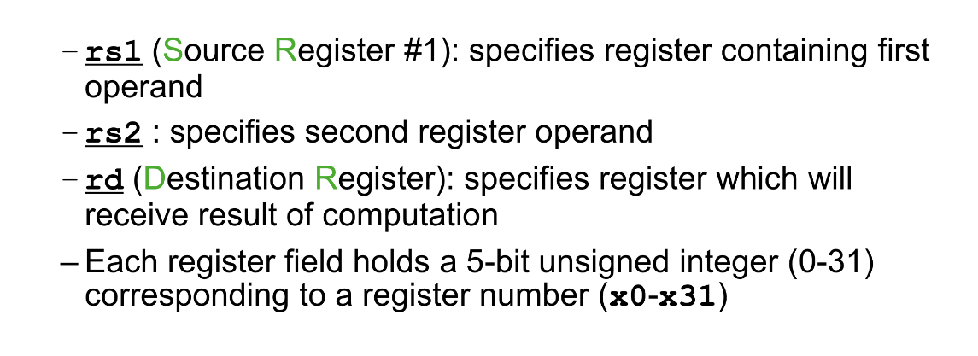
2.8 The RISC-V Architecture
RISC-V Instruction Format
R型指令

Slide 132
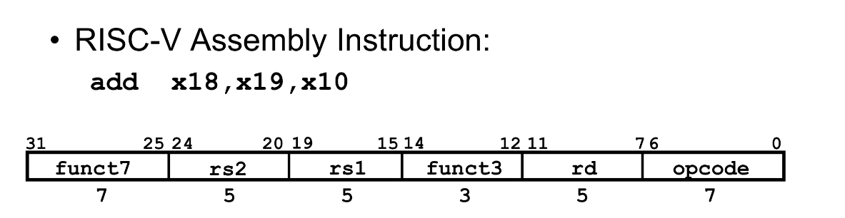
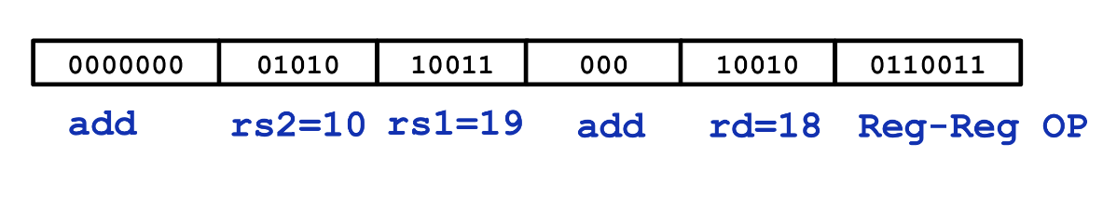
2.8 The RISC-V Architecture
RISC-V Instruction Format
R型指令

Slide 133
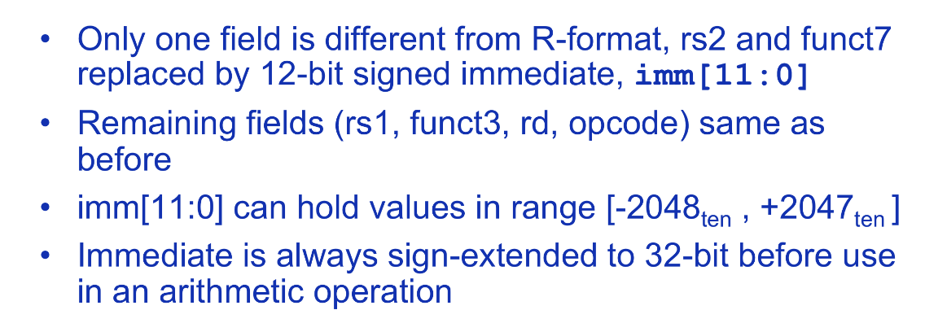
2.8 The RISC-V Architecture
RISC-V Instruction Format
I型指令

Slide 134
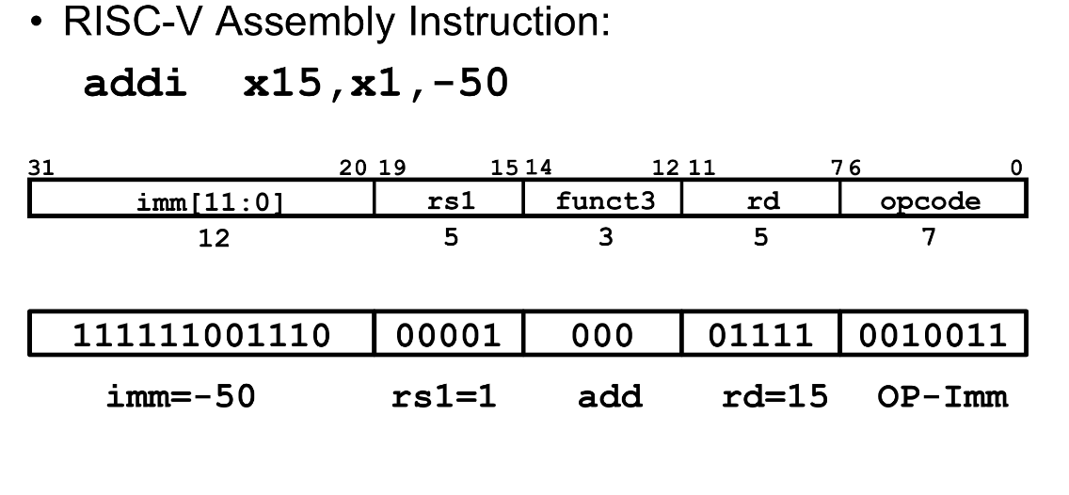
2.8 The RISC-V Architecture
RISC-V Instruction Format
I型指令

Slide 135
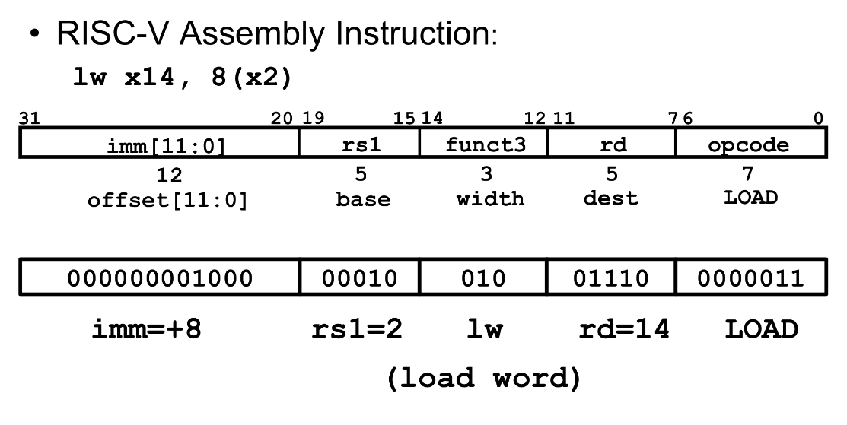
2.8 The RISC-V Architecture
RISC-V Instruction Format
I型指令

Slide 136
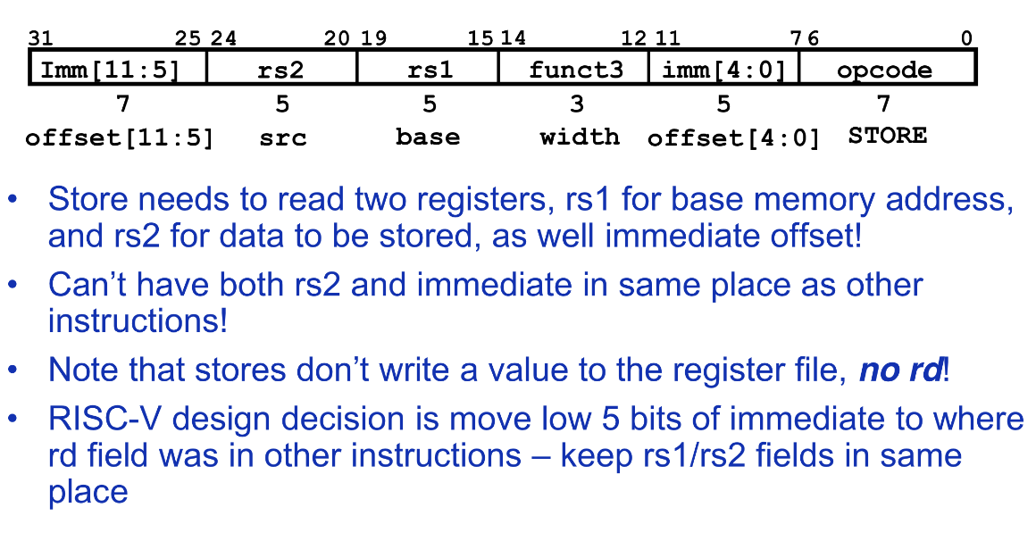
2.8 The RISC-V Architecture
RISC-V Instruction Format
S型指令

Slide 137
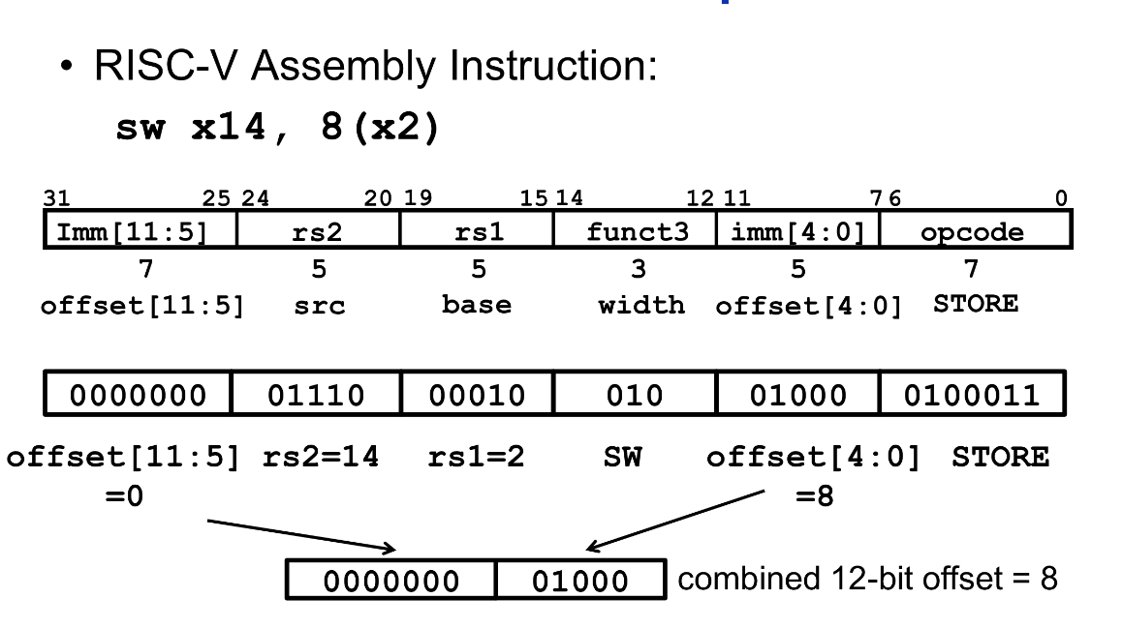
2.8 The RISC-V Architecture
RISC-V Instruction Format
S型指令

Slide 138
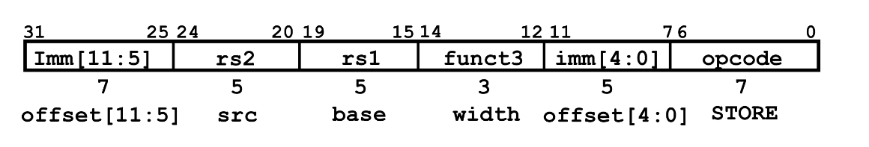
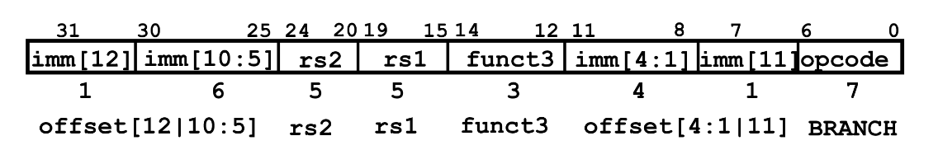
2.8 The RISC-V Architecture
RISC-V Instruction Format
S型指令
B型指令

Slide 139
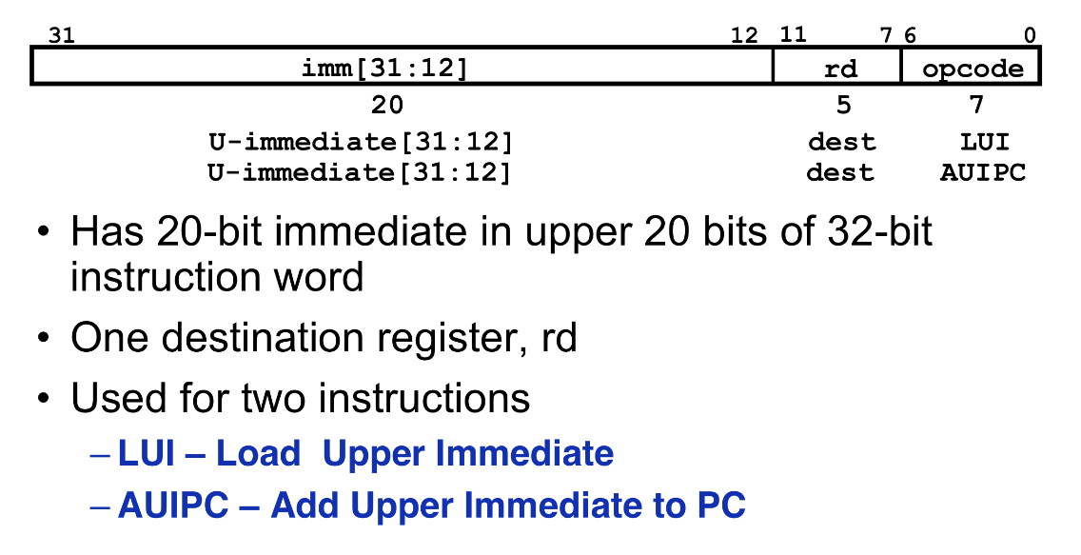
2.8 The RISC-V Architecture
RISC-V Instruction Format
U型指令

Slide 140
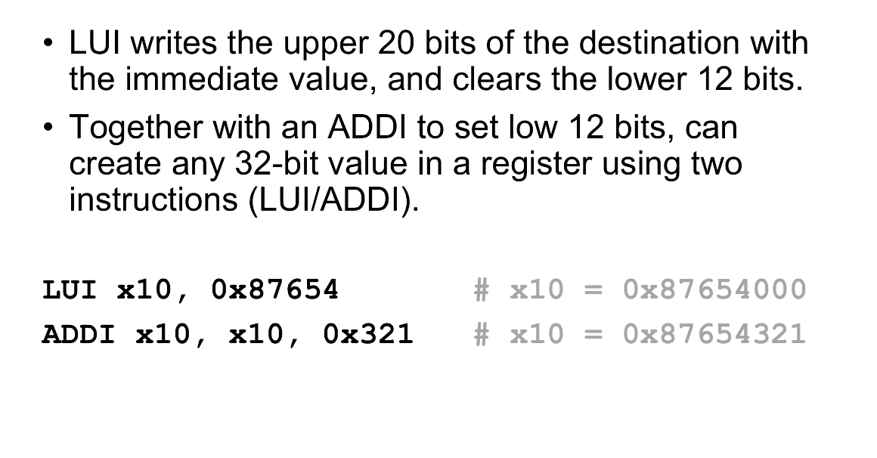
2.8 The RISC-V Architecture
RISC-V Instruction Format
U型指令

Slide 141
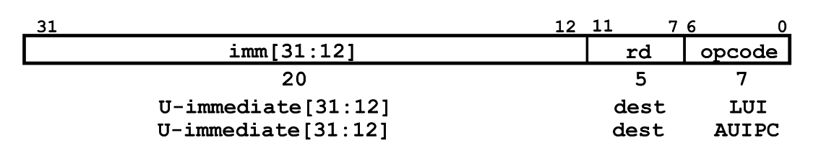
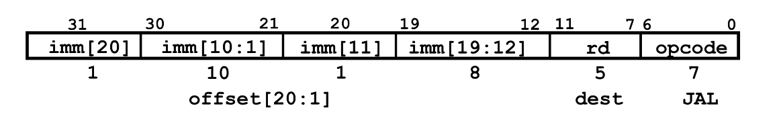
2.8 The RISC-V Architecture
RISC-V Instruction Format
U型指令
J型指令

Slide 142
2.9 Intel VT-capable Instruction Set
Virtualization is used by major processor vendors. Intension: enhance the processor’s ability to create and manage virtual resources from physical computing assets. 意图: 从物理计算资源中生成和管理虚拟资源
Intel Virtualization Technology (VT): enables a CPU to act as if it were several CPUs working in parallel, in order to enable several OSs to run at the same time in the same machine. 使CPU的所做如同有若干个CPU在并行运行，使得系统可在同一时间、在同一台机器上运行若干个操作系统。
Virtualization Technology: not new, there is some software on the market , VMware is the most famous one. 并非新技术

Slide 143
2.9 Intel VT-capable Instruction Set
Why implement VT inside CPU:
CPUs with VT have new instructions to control virtualization. 有新的控制虚拟的技术
With them, controlling software (called VMM, Virtual Machine Monitor) can be simpler, thus improving performance compared to software-only solutions. 由此，控制软件VMM更简单，性能提高。

Slide 144
2.9 Intel VT-capable Instruction Set
Intel processors with VT: 带VT的Intel处理器
* have a extra instruction set called Virtual Machine Extensions(VMX), define processor level support for virtual Machines. 有额外的指令集(VMX)为虚拟机提供处理器级的支持
* These instructions are categorized into VMX root operation, VMX non-root operation, as well as VMX transitions between root and non-root. 指令分类
* Examples: VMPTRLD, VMPTRST, VMCLEAR, VMREAD, VMWRITE, VMCALL, VMLAUCH, VMRESUME, VMXOFF, VMXON, INVEPT, INVVPID
(for explanation see page 2-31~2-32).

Slide 145
2.9 Intel VT-capable Instruction Set
Virtual machine control structure (VMCS): 虚拟机控制结构 –一种数据结构
*VMX non-root operation and VMX transitions are controlled by VMCS. 控制VMX非根操作和转换。
* Access to the VMCS is managed through a component of processor state called the VMCS pointer(one per logical processor). 对VMCS的访问是通过VMCS指针来管理的。
* VMCS pointer: (1) can be read and written using the VMPTRST and VMPTRLD. (2) configured by VMM using VMREAD, VMWRITE, and VMCLEAR.
* A VMM could: (1) use a different VMCS for each VM it supports. (2) the use a different VMCS for each virtual processor (for a VM with multiple logical processors(virtual processors)).

Slide 146
2.9 Intel VT-capable Instruction Set
VMM and Guest Software:
* VMM: Virtual Machine Monitor, is virtualization controlling software. Usually only VMM runs under root operation. 通常只有VMM运行于根操作下。
* Guest Software: the operating systems running on top of virtual machines runs under non-root operation. 客户软件工作于非根操作下。
* Figure 2.20 illustrates the interaction between a VMM and its guest software.

Slide 147
2.9 Intel VT-capable Instruction Set
Guest0
Guest1
VMRESUME
VMRESUME
VMLAUNCH
VMXON
VMM
VMOFF
Fig. 2.20: VMM与Guest交互

Slide 148
2.9 Intel VT-capable Instruction Set
Fig. 2.20：
* To enter virtualization mode, the software should execute VMXON and then call the VMM. 进入虚拟模式，软件应先执行VMXON,然后调用VMM。
* Then VMM enter each VM using VMLAUNCH, and exit it by using the VMRESUME. 然后VMM用VMLAUNCH进入每个虚拟机, 并用VMRESUME退出。
* If VMM wants to shutdown and exit virtualization mode, it executes the VMXOFF instruction. 如果VMM要关机并退出虚拟模式, 就执行VMOFF指令。
* Each guest shown can be a different OS, running its own software (even several programs at the same time). 每个客户可是不同的, 运行自己的软件。

Slide 149
Chapter 2 Instruction Set Architecture
2.1 Classifying Instruction Set Architecture
2.2 Interpreting Memory Address
2.3 Addressing Modes
2.4 Optimizing Instruction Formats
2.5 Operation in the Instruction Set
2.6 RISC vs. CISC
2.7 The DLX Architecture
2.8 The RISC-V Architecture

